Slide 1
Christopher B. Barrett Presentation to IFPRI webinar on Near-Real-Time Monitoring of Food Crisis Risk Factors: State of Knowledge and Future Prospects” May 8, 2020
Can Publicly Available Data and Machine Learning Accurately Predict Malnutrition and Poverty?

Slide 2
Can Publicly Available Data and Machine Learning Accurately Predict Malnutrition and Poverty?
PIs: Ying Sun, David Matteson, Chris Barrett (Cornell), Leiqiu Hu (Alabama), Yanyan Liu (IFPRI), Linden McBride (St. Mary’s) with Chris Browne and Jiaming Wen
Our project: A USAID-funded, multi-disciplinary effort to generate new data products (SIF, LST) and use those and other publicly-available data and cutting-edge ML methods to predict FtF poverty and malnutrition indicators at high spatial resolution. Can cheaper, higher frequency, accurate estimates supplement (or replace?!?) large-scale survey-based ones?

Slide 3
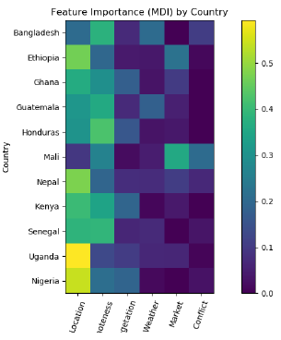
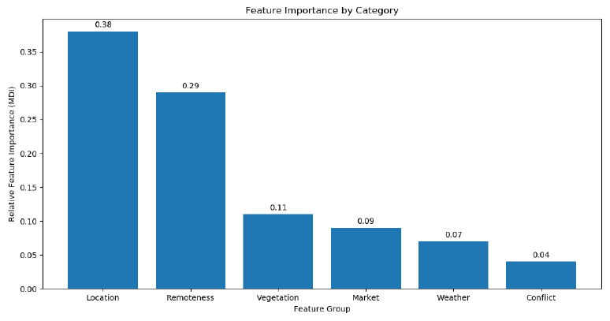
Can Publicly Available Data and Machine Learning Accurately Predict Malnutrition and Poverty?
Our preliminary findings:
Promising, but beware of over-optimism.
Data: Geography, veg growth and
market price feature sets are key
overall, w/ some cross-country variation

Slide 4
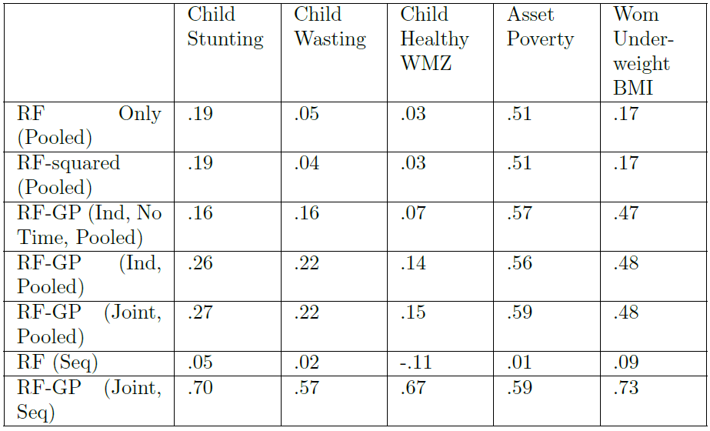
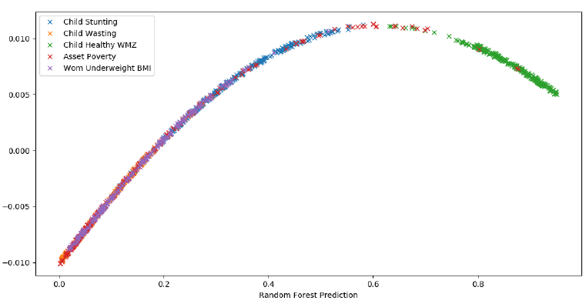
Can Publicly Available Data and Machine Learning Accurately Predict Malnutrition and Poverty?
Methods: Simpler RF+GP do ~ as well as more complex deep/transfer learning. GP to exploit covariances significantly improves OOS fit, esp. for hard-to-predict malnutrition indicators, but doesn’t change prevalence estimates much.
Tasks: Easier to predict asset poverty and child healthy WHZ.

Slide 5
Thank you
Thank you for your interest
Comments/questions?

